Slide 1

Context
Number of Audience
15 – 20 People
Scenario
4.5 Capstone Project Activity:
Think of the best scenario that you would want to present.
Identify your set of target audience.
Choose a topic you want to present.
Sales Performance Review
Topic
Celebrating Achievements & Planning for Success
Target Audience
Sales Team
& Management
Notes:
Greetings!
As context --- for this capstone project activity, the best scenario that I would want to present is regarding Sales Performance Review.
The target audience would be the Sales Team & Management, having an estimated of 15-20 people.
Under this scenario, the focus or agenda would be about “Celebrating Achievements & Planning for Success”.
Let’s GO!

Slide 2

Sales Performance Review
SP503: Storytelling Using Data
Juven Dale Q. Colaste
Data Scientist Pathway – SPARTA Scholar
Notes:
Good day, ladies and gentlemen!
Thank you for joining us today.
I’m Juven Dale Q. Colaste, thrilled to take you through our Sales Performance Review.
------------------------------------
Today, we'll cover key insights into our sales performance, recognize the achievements of our dedicated sales team, and discuss our future strategies.

Slide 3

Agenda
Introduction
Overall Sales Overview
Sales Team
Summary
What’s next
Notes:
Here's how we will navigate through today's discussion:
We'll start by setting the stage for our presentation --- INTRODUCTION, To provide context and highlight the data sources and importance of this review.
Next, we will dive into the heart of the matter --- our Overall Sales Overview, a detailed overview of our sales performance. We'll discuss key metrics, growth percentages, and notable achievements that defined our years.
We will then shift our focus to our vanguards, the face of our success, our --- exceptional Sales Team.
We will take a moment to recognize and celebrate their outstanding efforts and contributions.
Followed by --- Summary, we will wrap up today's discussion by expressing our gratitude for the presence and highlighting our shared commitment to an even more prosperous future.
And Finally, looking forward on our --- “What’s Next” to outline our questions or discussions we may have.
Are we ready?

Slide 4

Introduction
Profits are up, and losses are down!
Today, we will review our sales progress from the last five (5) years to gain insight and adjustments to our incoming years.
Invoices.xls
OrderLeads.xls
SalesTeam.xls
Notes:
Profits are up, and losses are down!
Today, we will review our sales progress from the last five (5) years to gain insight and adjustments to our incoming years.
--------------------------
The data I used to do the review comes from the Excel files as follows:
invoices.xls:
To gather information on Order Date, Meal Price, and Company Id for yearly sales trends.
orderleads.xls:
To assess our yearly conversion rates and Order Values.
salesteam.xls:
To recognize the contributions of each Sales Representatives and their respective accounts over the past years.

Slide 5

Results from the last five (5) years [2018 – 2022]
Let’s dive in
Notes:
And here are the results from the last five (5) years, 2018 – 2022.
To start, we will begin with a line chart of our sales data!

Slide 6
Sales Growth Over the Years
1.30%
Sales Growth Rate
2021 - 2022
+ ₱ 52,255.00
0.88%
Overall Sales Growth Rate 2018 - 2022
+ ₱ 35,393.00
Notes:
As we can see, our line chart starts in 2018 at 4.03 million pesos in total sales.
We maintained this level in 2019 and 2020 --- however, it slightly dipped to 4.01 million in 2020, followed by a modest increase to 4.02 million in 2021, and a significant boost to 4.07 million in 2022.
Despite facing setbacks in 2019 to 2021 due to the pandemic, we made a strong comeback in --- 2022 with a sales growth of 1.30%. While this growth may seem modest, it amounts to an additional 52,255.00 pesos. Which means, we still consistently maintained our total sales of above 4 million pesos each year.
And over these years, we --- had an overall sales growth rate of 0.88.
This means, on top of our 4 million baseline from 2018 --- 35,393.00 pesos has been added representing our growth and ability to adapt and thrive in a changing market.
Now, these figures were made possible by having a closer look at our conversion rates.

Slide 7
Conversion Rate Over the Years
8.45%
Conversion Growth Rate
2018 - 2022
+ 8,448 Orders
2.07%
Average Conversion Growth Rate 2018 - 2022
+ 2,066 Orders
Notes:
At 2018, our conversion rate was 80.72%, setting the baseline for our performance.
Despite fluctuations in our total sales in 2019 and 2020 due to pandemic, our conversion rate consistently remained above 80%.
And at 2021, we experienced significant growth with a conversion rate of 84.84%.
The momentum continued into 2022, where we achieved an impressive 87.54% conversion rate, marking substantial progress.
This means our --- overall conversion rate growth from the 2018 baseline to 2022 is 8.45%.
In practical terms, this translates to an additional 8,448 orders compared to our 2018 baseline.
On average, we maintained --- a 2.07% annual average conversion rate growth.
This implies that each succeeding year, we at least secured an additional 2,066 orders.
What can we learn from this data?
Over the years, we've not only maintained a solid conversion rate but have also witnessed consistent growth. The most notable increase occurred in 2021, highlighting the effectiveness of our strategies in capturing more conversions.
As we look ahead, our challenge is to sustain and build upon this growth trend.
Now that we've explored our sales performance and conversion rates, let's shift our focus to a powerful strategy that helps us better understand and cater to our valued customers: Customer Value Segmentation.

Slide 8
Customer Value Segmentation
a strategy used by businesses to categorize their customers into different groups based on their value to the company.
Top Customers
Loyal Customers
At Risk/Need Attrition
Immediate Attention
Notes:
Customer Value Segmentation --- is a strategy used by businesses to categorize their customers into different groups based on their value to the company.
This segmentation allows us to tailor our approach to each group, ensuring that we maximize our efforts and provide the best possible service.
According to this strategy, we classify our customers into four key segments:
First, we have our 'Top Customers.' These are the customers who consistently contribute the highest revenue, make frequent and substantial purchases, and often have a long-term relationship with our company.
Next, we have 'Loyal Customers.' These are the customers who consistently choose to do business with us over an extended period of time, demonstrating their trust and satisfaction.
Moving on, we encounter the 'At Risk/Need Attrition' segment. These are customers who may be showing signs of reduced engagement, decreased purchasing activity, or dissatisfaction with our products or services. It's crucial for us to identify and address their concerns promptly.
Lastly, we have the 'Immediate Attention' segment. These are customers that require urgent and immediate action or intervention. This signifies that there is a critical issue, problem, or opportunity that needs to be addressed promptly to ensure customer satisfaction and seize valuable opportunities.
Now, let me illustrate the significance of this strategy with a practical example using RFM Analysis.

Slide 9
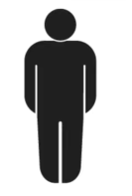

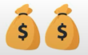
Customer Value Segmentation
Customer 2
Customer 1
Customer 2
Customer 1
RFM ANALYSIS
Total Spend
₱ 1,000
Monetary
Total Spend
₱ 2,000
Total Spend
₱ 1,000
Total Spend
₱ 2,000
Frequency
Recency
2 Years Ago
2 Years Ago
Last 12 Months
Last 12 Months
Notes:
We have two (2) customers.
One (1) customer has a total spend of 2,000.00 pesos.
While the other has a total spend of 1,000 pesos.
Which one is more valuable? The first, right?
-----------------------------
Now, our dataset expands to the customer’s purchase history.
Our first customer has one purchase history 2 years ago. --- While the other has four (4) purchase history in the last twelve (12) months.
Which one is now more valuable?
And that is our customer value segmentation using RFM Analysis stands for:
Recency, Frequency and Monetary.
Recency, refers to how recently a customer has made a purchase. In our case, 2 years ago for customer one(1) and last 12 months for customer two (2).
Frequency, measures how often a customer makes a purchase within a defined time frame. That would be once for customer one (1) and four (4) times for customer two (2).
Monetary, represents the total monetary value of a customer's purchases within a specified time frame. 2,000 pesos for customer one (1) and 1,000 pesos for customer two (2) for each purchase.
Through this Analysis Technique, we were able to come up with this customer segmentation distribution.

Slide 10
Customer Value Segmentation
Immediate Attention, 21 %
Immediate Attention, 20.88%
Top Customers, 17.25%
Top Customers,
17 %
At Risk/ Need Attrition, 31.38%
Loyal Customers, 17.25%
At Risk/ Need Attrition, 31 %
Loyal Customers, 31 %
Notes:
Starts with our Top Customers, having 17%.
Loyal Customers, 31%.
At Risk/Need Attrition, 31%.
And Customers that need Immediate Attention, 21%.
Creating a whole pie diagram.
To summarize, ---

Slide 11
Customer Value Segmentation
TOP CUSTOMER SEGMENT:
Monetary Average: ₱ 450.90
Frequency Average: 14
Latest Purchase History: 12-31-2022
17%
Immediate Attention, 20.88%
Top Customers, 17.25%
At Risk/ Need Attrition, 31.38%
Loyal Customers, 17.25%
IMMEDIATE ATTENTION SEGMENT:
Monetary Average: ₱ 338.95
Frequency Average: 8
Latest Purchase History: 12-13-2022
21%
Notes:
The --- 17% Top Customer Segment has an average spending of 450.90 pesos, and they make purchases quite frequently with an average frequency of 14 transactions. What's even more remarkable is that their latest purchase history was as recent as December 31, 2022. This demonstrates their loyalty and consistent engagement with our products and services.
Now, contrast that with the --- 21% Customer Segment that requires 'Immediate Attention.' Their average spending stands at 338.95 pesos, and they have an average frequency of 8 purchases. Despite some concerns, we've noticed their latest purchase history was also relatively recent, recorded on December 13, 2022.
The key points of difference between these segments are clear:
Spending: The Top Customer Segment showcases higher average spending compared to the Immediate Attention Segment, indicating a greater financial commitment.
Frequency: Top Customers engage more frequently, with an average of 14 transactions, whereas Immediate Attention customers have 8 transactions on average.
Now, what valuable insights can we draw from these distinctions?
We can see that our customers exhibit diverse behavior patterns. Some are consistent and highly engaged buyers (Top Customers), while others show potential but might need additional attention (Immediate Attention Segment). The Immediate Attention Segment, with its recent purchases, presents an opportunity for growth and improvement. By addressing their concerns or needs promptly, we can potentially turn them into more loyal customers.
Overall, this detailed understanding of our customer segments empowers us to take strategic actions. We can tailor marketing campaigns and communication specifically to the preferences and behaviors of these segments.
But, let's not forget the driving force behind these successes. Who are the sales representatives responsible for nurturing and maintaining these valuable customer relationships?

Slide 12
Customer Value Segmentation
Sales Representative Value Segmentation
Sales Rep. 2
Customer 1
Customer 2
Sales Rep. 1
RFM ANALYSIS
Monetary
Total Sales
₱ 2,000
Total Spend
₱ 1,000
Total Spend
₱ 2,000
Total Sales
₱ 1,000
Frequency
Recency
2 Years Ago
Last 12 Months
Notes:
Ultimately, for us to be able to know our noted sales representatives --- we can apply a similar concept used in customer value segmentation through RFM Analysis. How?
Let’s do a substitution in 3, 2, 1!
Alright! Our sales representative 1 has a one (1) sale amounting to 2,000 pesos last 2 years ago. Meanwhile, our sales representative 2 has four (4) sales amounting to 1,000 pesos each in the last 12 months.
Which one is more valuable?
And that is our sales representative value segmentation using RFM Analysis, we gain a deeper understanding of their contributions --- much like we did with our customers.
So, let's take a look at the breakdown.

Slide 13
Sales Representative Value Segmentation
8% - Outstanding Customer Handlers
21% - Excellent Customer Handlers
6% - Average Customer Handlers
42% - At Risk/Need Improvement
22% - Immediate Attention
Notes:
Starting with the Outstanding Customer Handlers, this segment comprises 8% of our sales team.
They have consistently demonstrated exceptional performance, earning high praise from our customers.
Moving on to Excellent Customer Handlers, representing 21% of our team.
They have been consistently strong performers, contributing significantly to our success.
At Average Customer Handlers segment, we have 6% of our team.
They form a crucial part of our sales force, delivering consistent results.
Now, in “At Risk/Need Improvement” category, which makes up 42% of our team.
These individuals require our attention and support to enhance their performance.
Lastly, the Immediate Attention segment represents 22% of our team.
These individuals require urgent intervention and coaching to address performance issues.
Overall ---

Slide 14
Sales Representative Value Segmentation
OUTSTANDING S.R. SEGMENT:
No. of “Need Attention” Accounts: 2
No. of “At Risk” Accounts: 2
No. of “Loyal” Accounts: 6
No. of “Top” Accounts: 3
Immediate Attention, 22%
Outstanding Customer Handlers, 8%
8%
Excellent Customer Handlers, 21%
22%
IMMEDIATE ATTENTION S.R. SEGMENT:
No. of “Need Attention” Accounts: 3
No. of “At Risk” Accounts: 5
No. of “Loyal” Accounts: 3
No. of “Top” Accounts: 2
At Risk/Need Improvement, 42%
Average Customer Handlers, 8%
Notes:
Overall, Starting with our ---- Outstanding Sales Representatives which comprises 8% from our sales team, they were able to convert and have these portfolio of accounts:
No. of "Need Attention" Accounts: 2
No. of "At Risk" Accounts: 2
No. of "Loyal" Accounts: 6
No. of "Top" Accounts: 3
Now, let's turn our attention to the --- Immediate Attention Sales Representative segment which comprises 22% from our sales team. They are also handling various accounts, and here's the breakdown of their account performance:
No. of "Need Attention" Accounts: 3
No. of "At Risk" Accounts: 5
No. of "Loyal" Accounts: 3
No. of "Top" Accounts: 2
To understand the difference in performance, we can observe some key points:
Our Outstanding Sales Representatives have a higher number of "Loyal" and "Top" accounts, indicating their success in maintaining strong client relationships and achieving remarkable results.
On the other hand, the Immediate Attention Sales Representatives have a higher number of "At Risk" accounts, suggesting areas that require immediate attention and improvement.
These are the difference in performance between the outstanding sales representative segment compared to immediate attention sales representative segment in terms of the success on the accounts they are currently handling.
What can we learn from this Sales Representative Value Segmentation?
As a context, we have a diverse sales team with varying levels of performance.
Recognizing these segments allows us to allocate resources effectively, provide targeted support, and drive success across our account portfolios.
In conclusion, we can implement tailored strategies to nurture their growth --- whether it's maintaining excellence or achieving improvement.

Slide 15
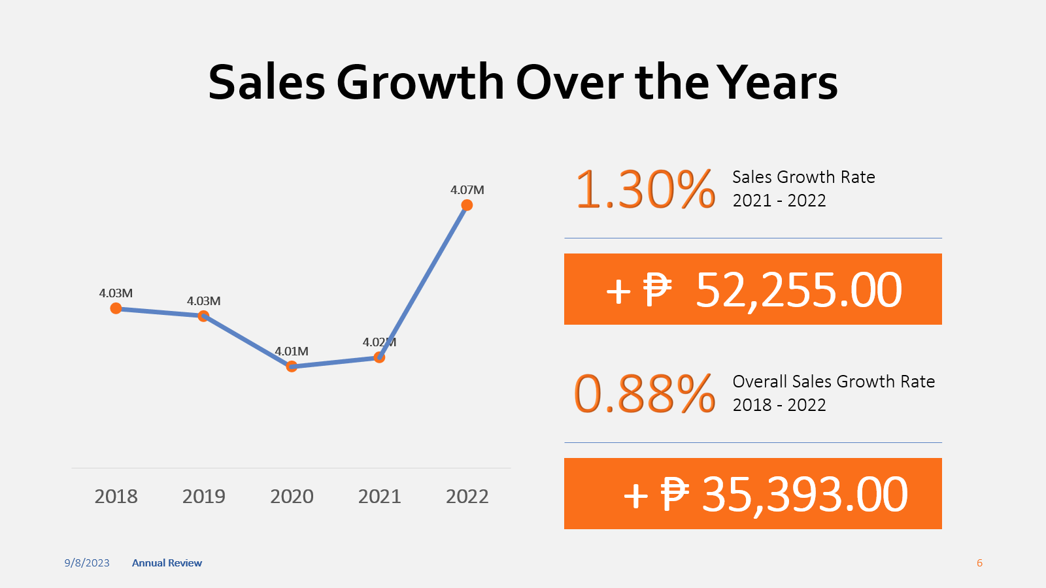
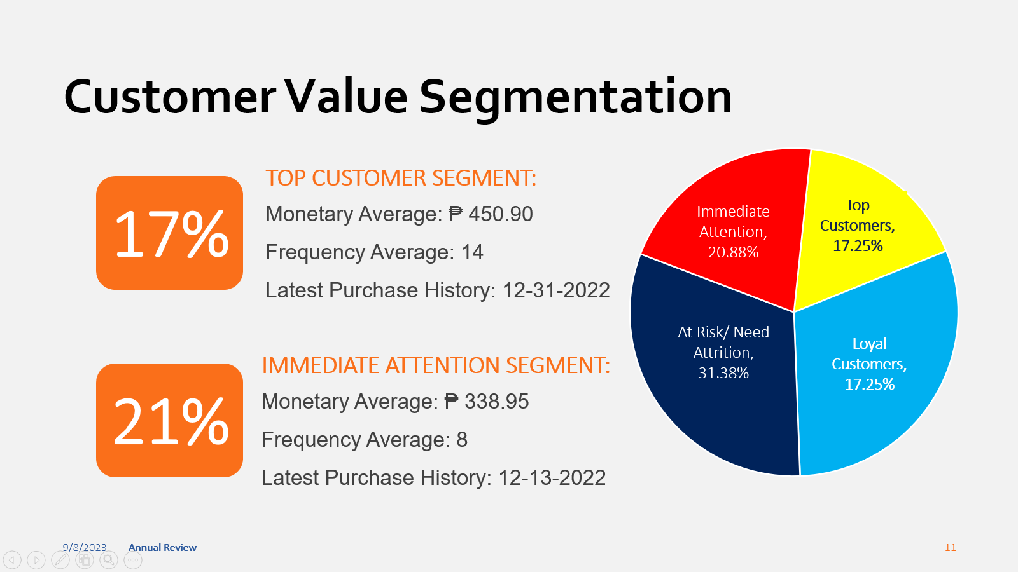
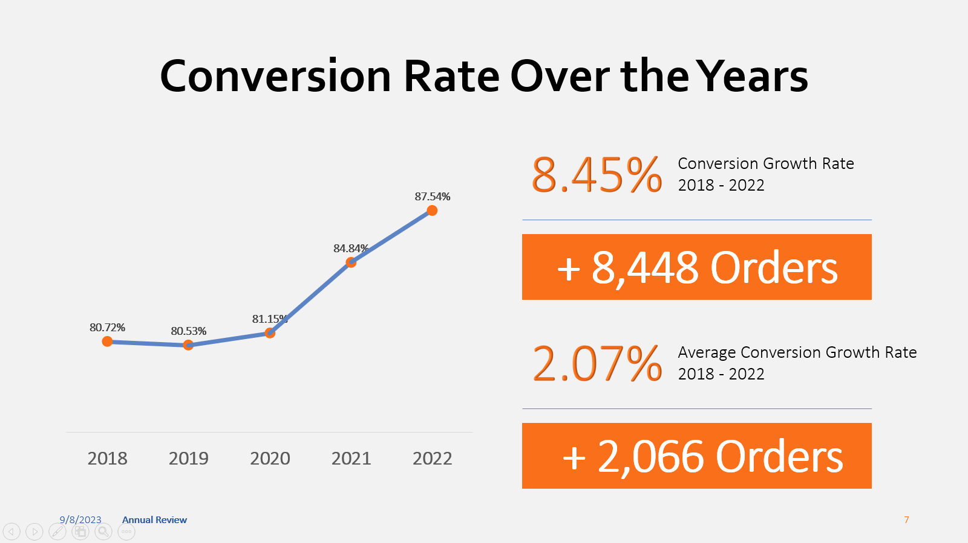
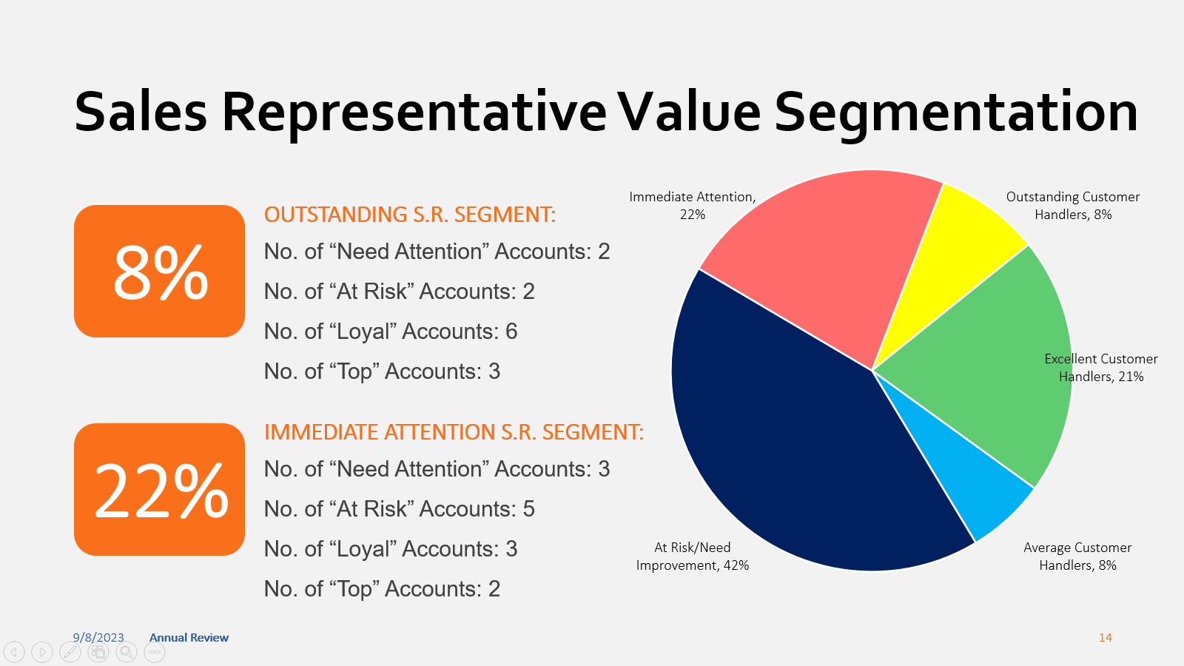
Summary
Notes:
Today's presentation has provided us with invaluable insights into our yearly sales performance.
We've reviewed our growth trends, conversion rates, and customer value segmentation. Additionally, we've recognized our outstanding sales representatives and addressed the importance of tailored strategies for various sales segments.
Before we conclude, I want to express my sincere gratitude to each one of you for your presence today. Your engagement and dedication to our shared goals are the driving force behind our success.
As we move forward, --- remember, our success is a collective effort, and together, we have the power to reach new heights.

Slide 16
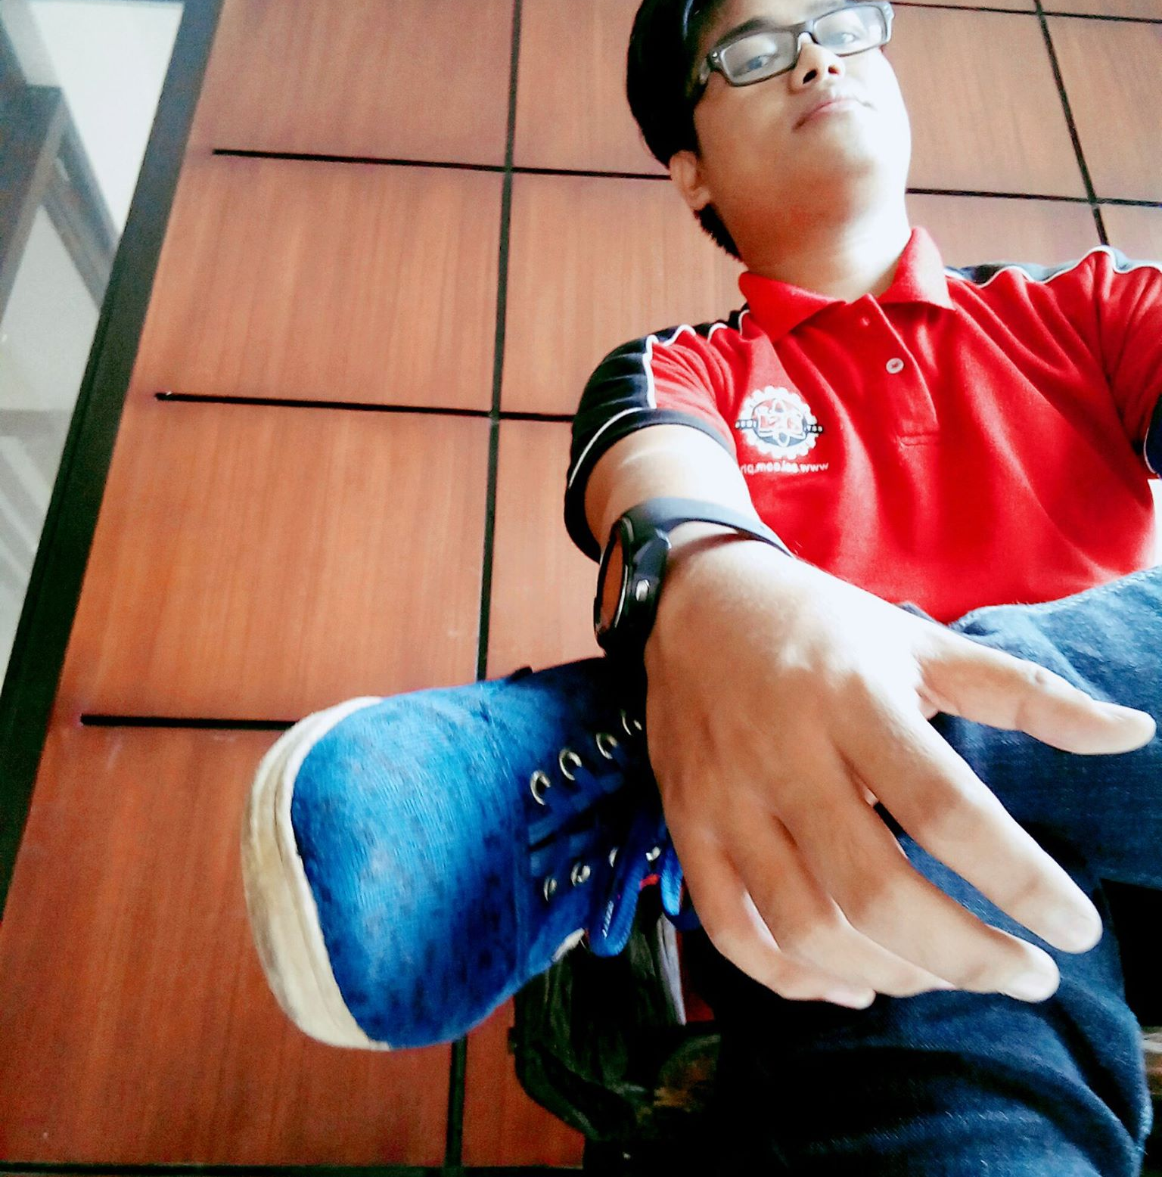
What’s NEXT?
“ Recognizing the performance differences empowers us to allocate resources wisely, offer precise support, and enhance success across our account portfolios. "
Juven Dale Colaste
SPARTA Scholar – Data Scientist Pathway
Notes:
So now, WHAT’s NEXT?
Recognizing the performance differences empowers us to allocate resources wisely, offer precise support, and enhance success across our account portfolios.“
Now, I'd like to open the floor for any questions or discussions you may have. Please feel free to share your thoughts, and let's engage in a productive dialogue. Thank you!

